Slide 1
Predicting Crime Rate Analysis in United states
Venkata Gayathri Peri
Sanjeev Peri
Dhirender Kumar Pandey
Vishnu kalyan Chakravarthi Korukonda

Slide 2
Context
Introduction
Understanding of Dataset
Methodologies/Classifier comparison
Fitting of Classifier
Output

Slide 3

INTRODUCTION
The frequency and variety of criminal activity are rising at an alarming rate, pushing organizations to create effective strategies for taking preventive action
predicting crime plays an important role in increasing a country’s economic development .
Datasets and methodologies for predicting crime are many. By using Chicago crime Dataset, we try to mitigate and prevent future crime.

Slide 4

Dataset
Our dataset shows recorded criminal offenses that took place in the City of Chicago between 2001 to the present.
Around 10,00,000 observations were jotted down 3,64,000 records to increase the scope for data analysis such that records from 2018 to 2023 are only considered.

Slide 5
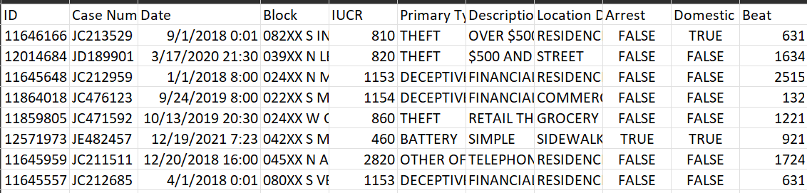
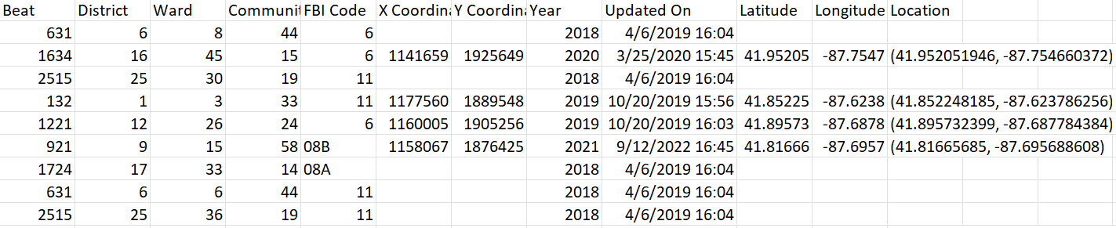
CHICAGO CRIME DATASET
It contains variables like case number, Description, Location, Arrest and district etc.
Data is cleaned by removing Null values, missing values from our Dataset.
We reduced unnecessary columns by using drop method and other pandas' functionalities.
Data imbalances are handled using resample package to up sample minority class of data

Slide 6
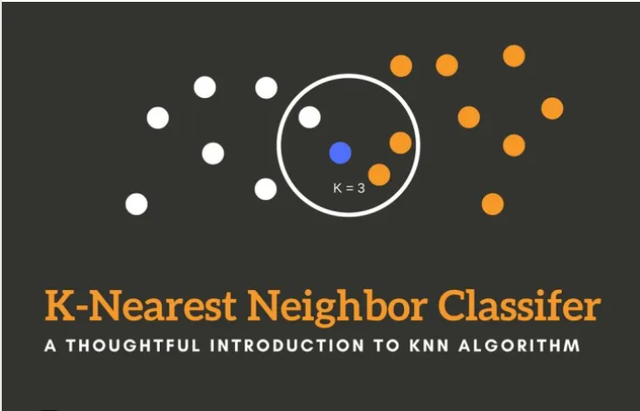
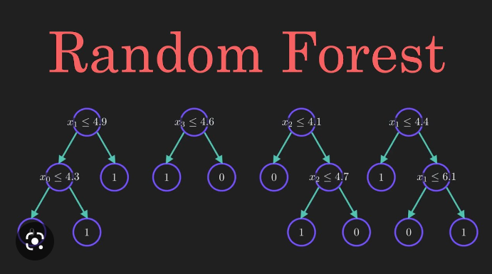
Methodologies COMPARISON
K-nearest neighbor (KNN) classifier is a type of instance-based learning algorithm in machine learning and data mining. It is a simple and effective classification algorithm that does not require any training, as it memorizes the entire training dataset. KNN is considered a non-parametric algorithm.
Random Forest is a supervised learning algorithm used for both classification and regression tasks. It is an ensemble learning method that builds multiple decision trees during training and combines their predictions to improve the accuracy of the model.

Slide 7
Accuracy percentage(%)
KNN -> 33.5%
RF -> 36.8%
For model selection or methodologies to be chosen, here we compared two algorithms – KNN and Random forest classifier most commonly used for crime data analysis. After calculating the accuracy precision f1 score and recall performance metrics we decided to proceed with random forest classifier to predict our data
Comparison of best models from each category:
Measures | Random Forest | KNN
Accuracy | 36.8% | 33.5%
F1-Score | 25.4% | 29.6%

Slide 8
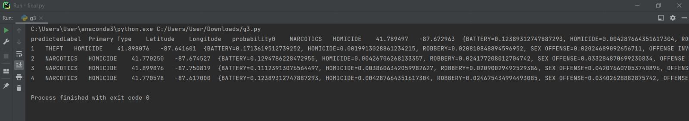
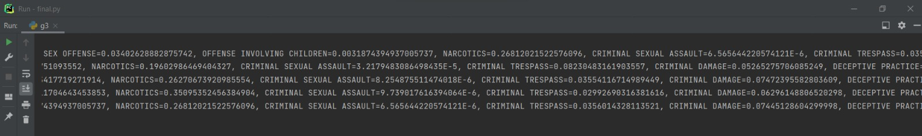
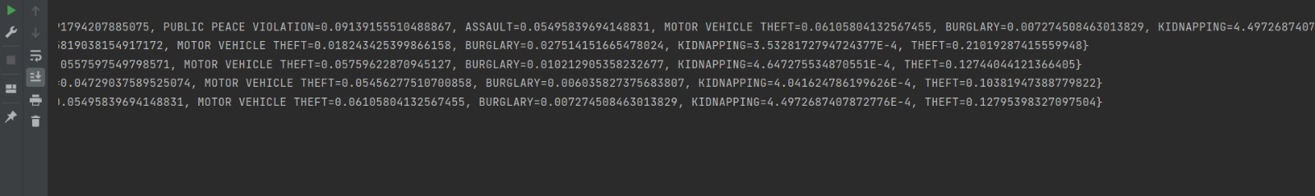
SUMMARY

Slide 9
Output
So, after all the data analysis and random forest classifier fitting, we were able to predict the probability for homicide type of crimes in our data.

Slide 10
THANK YOU

